Slide 1
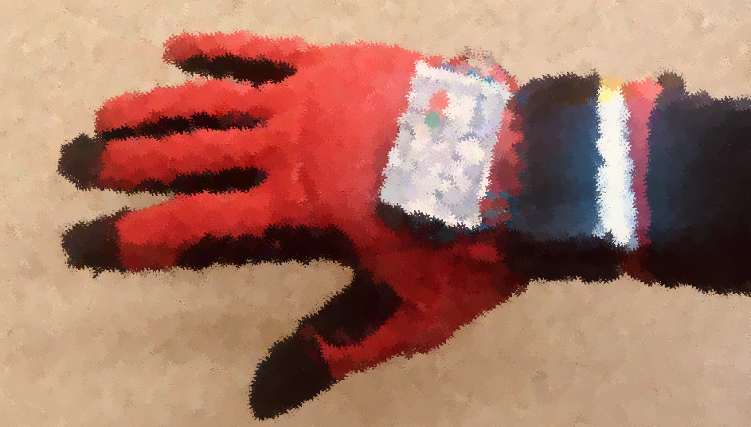
The KeyGlove
1

Slide 2
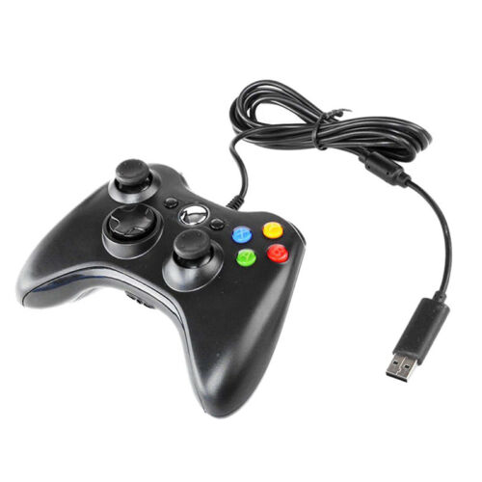
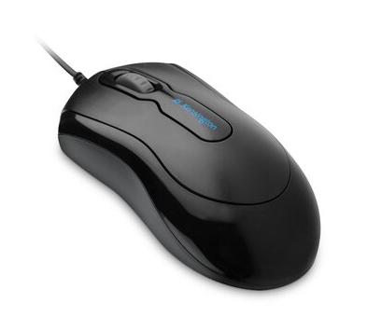
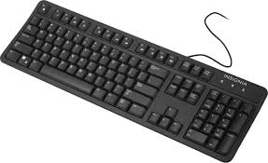
Human Computer Interface
A human-computer interface (HCI) is the mean of communication between a human user and a computer system.
The use of input/output devices with supporting software.
Devices of increasing sophistication are becoming available to mediate the human-computer interaction.

Slide 3
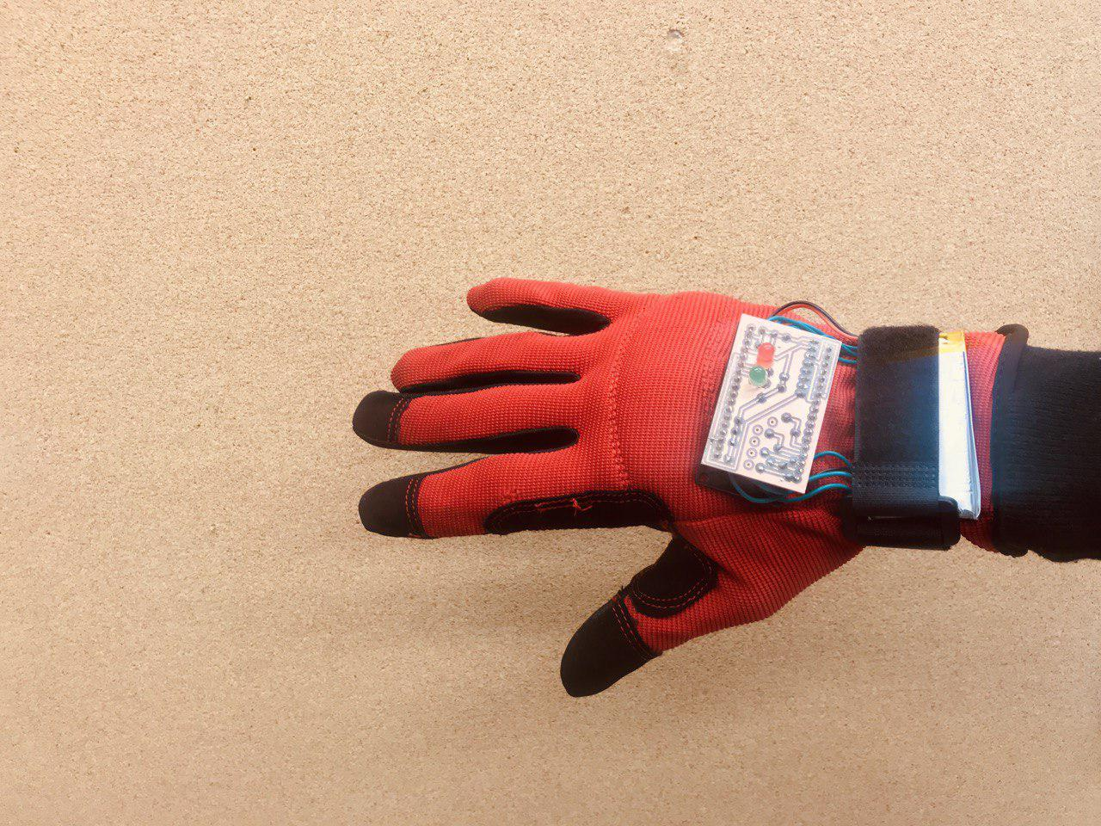
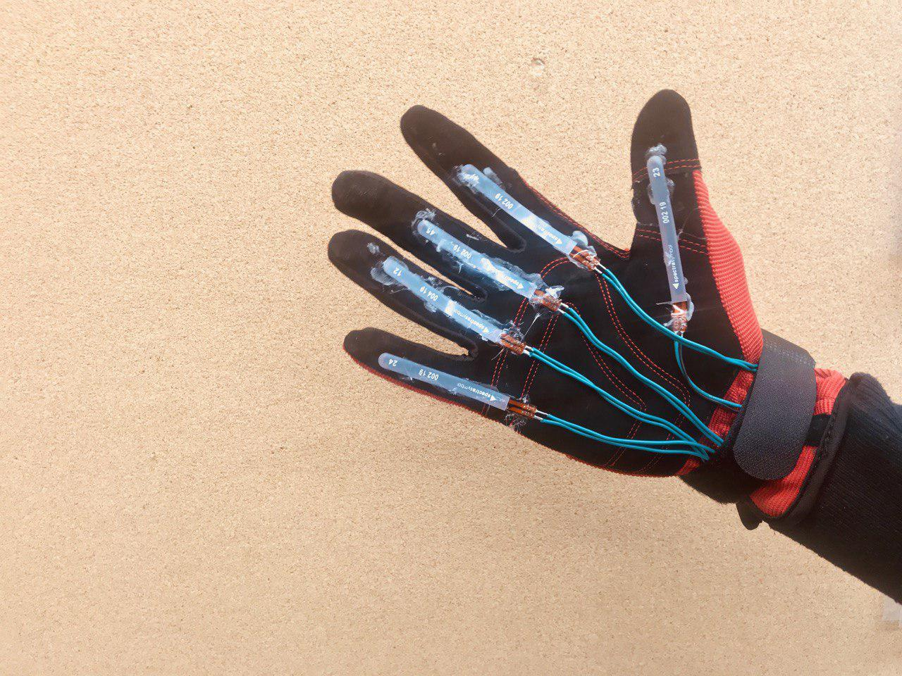
The KeyGlove
Hand motion tracking
Five different keys
Light and easy to wear
It can replace a mouse, a joystick or a keyboard
Different modalities are implemented

Slide 4
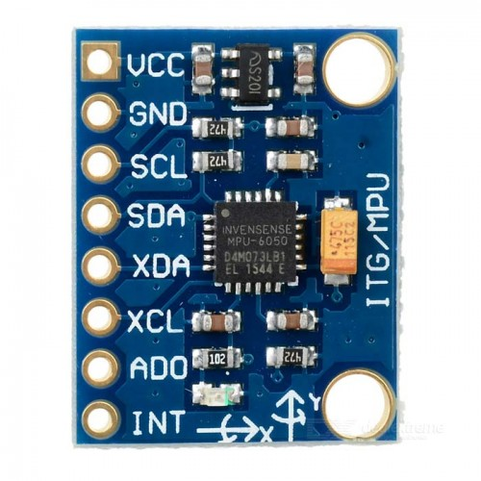
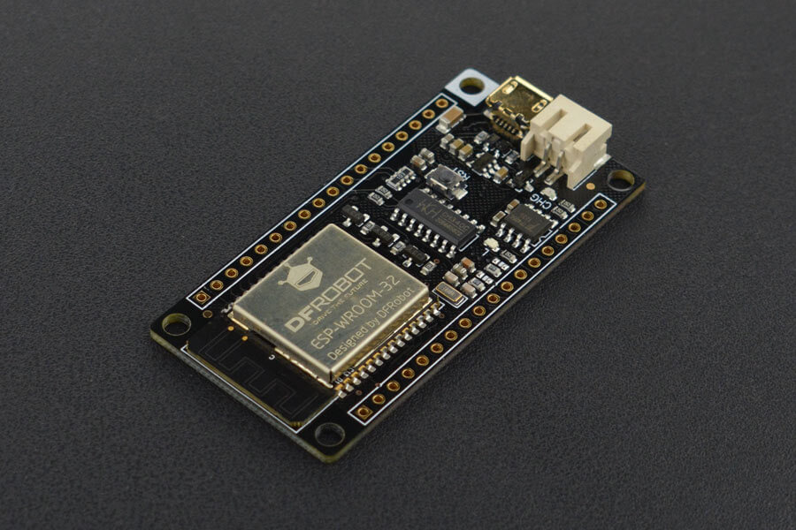
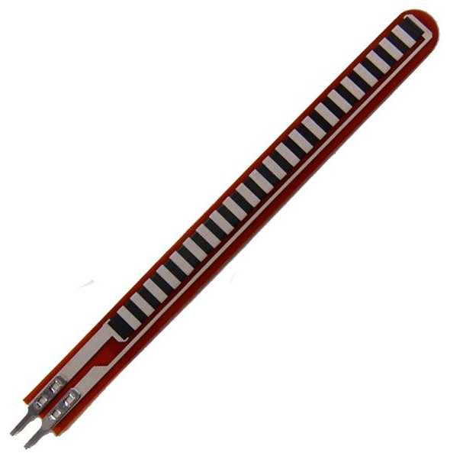
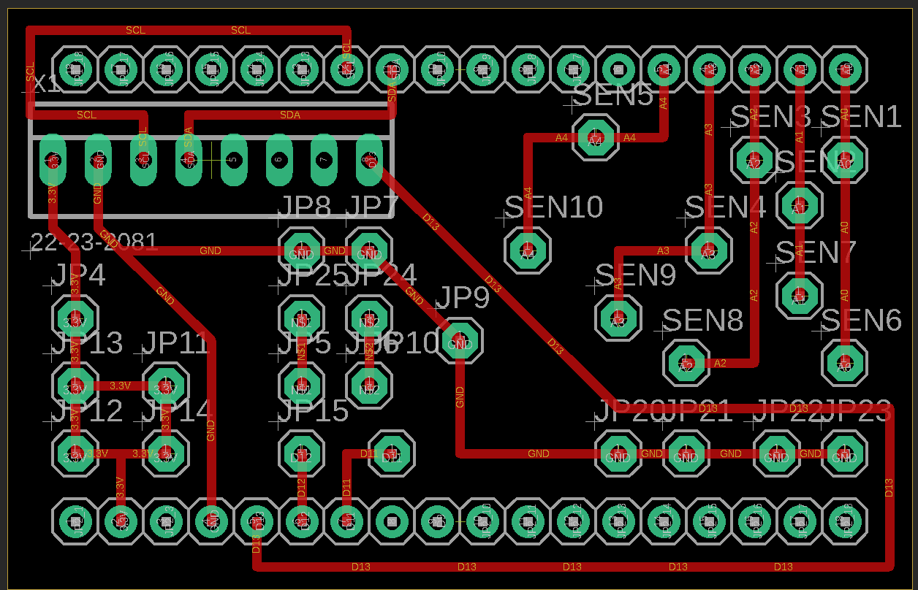
Hardware
x2 FIreBeetle esp32 (central and peripheral)
x5 flex sensors
Gyroscope MPU6050
PCB
x5 22kΩ resistors
x2 LEDs
x2 100Ω resistors

Slide 5
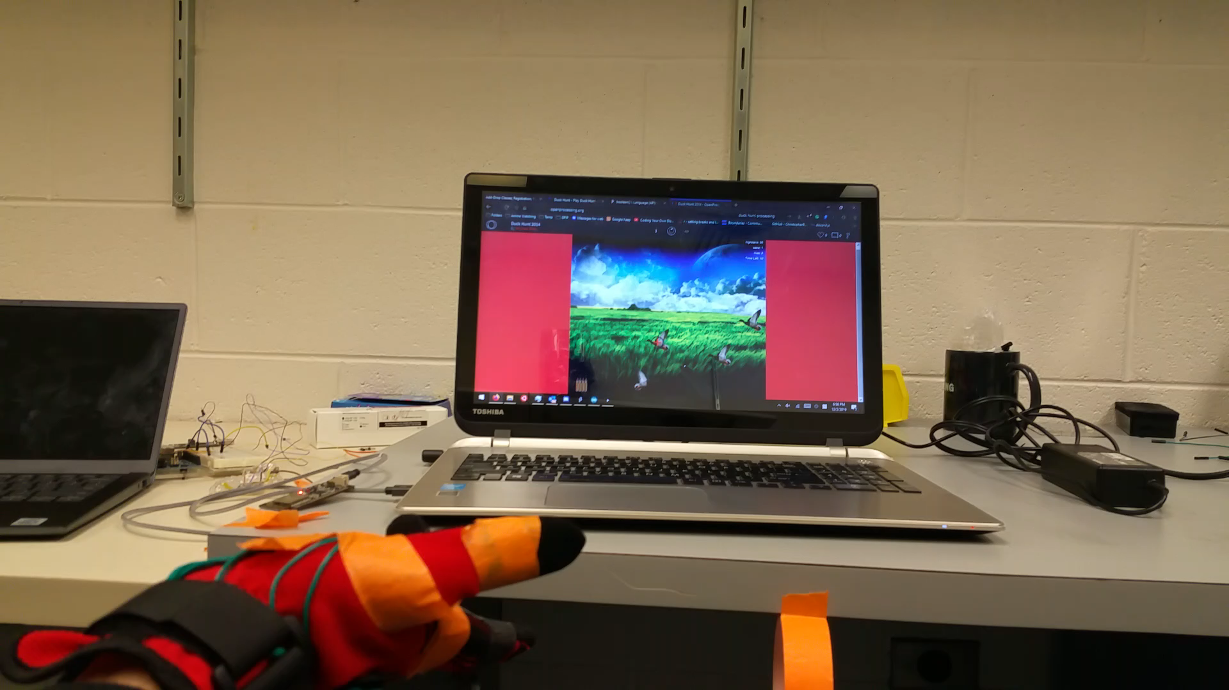
VIDEO DEMO

Slide 6
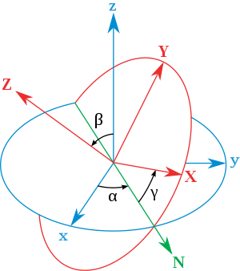
Arduino
Gyroscope:
Libraries “Wire.h” and “MPU6050_6Axis_MotionApps20.h” used
Euler Angles are computed
Calibration phase
I2C communication (SCL and SDA)
Interrupts enabled every time the value of an angle changes

Slide 7
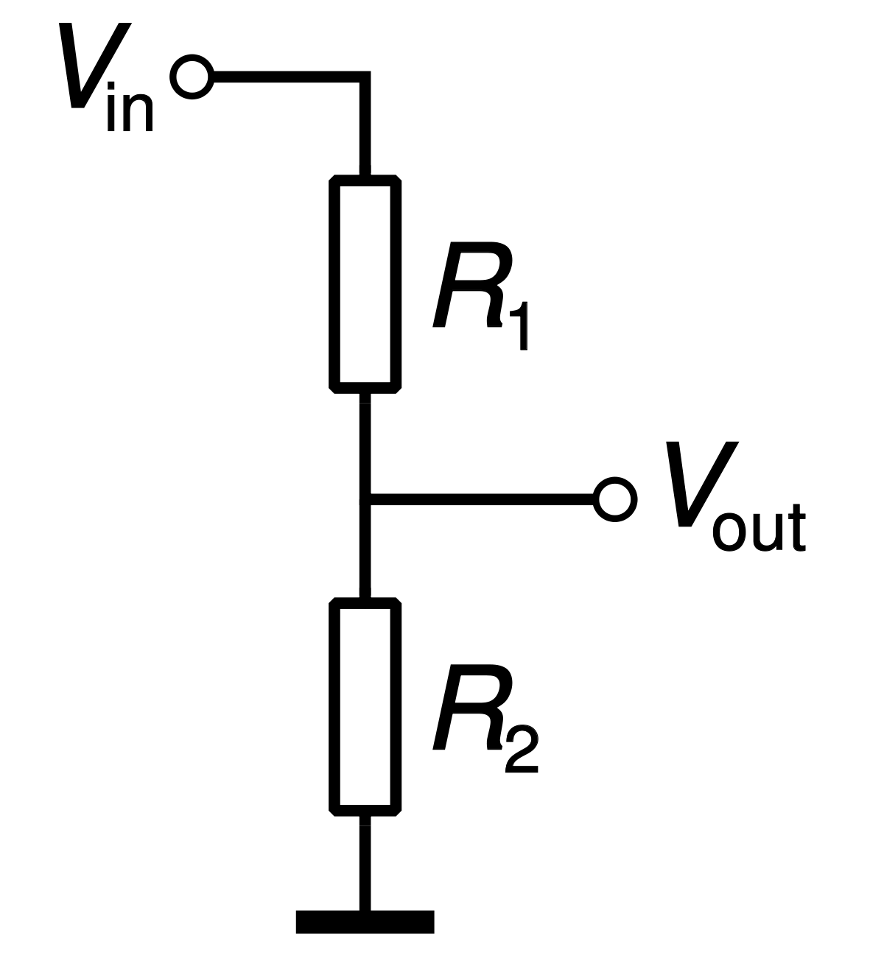
Arduino
Flex Sensors:
Voltage divider to sense the resistance change of the flex sensor
Thresholds are computed empirically
Sampling frequency 20 Hz
Analog Read:
If raw value<threshold 🡪 Flex
If raw value>threshold 🡪 No flex
Flex sensor
22kΩ

Slide 8
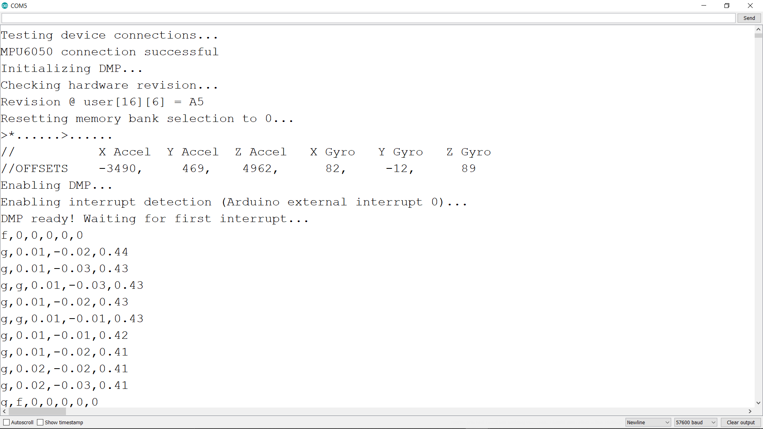
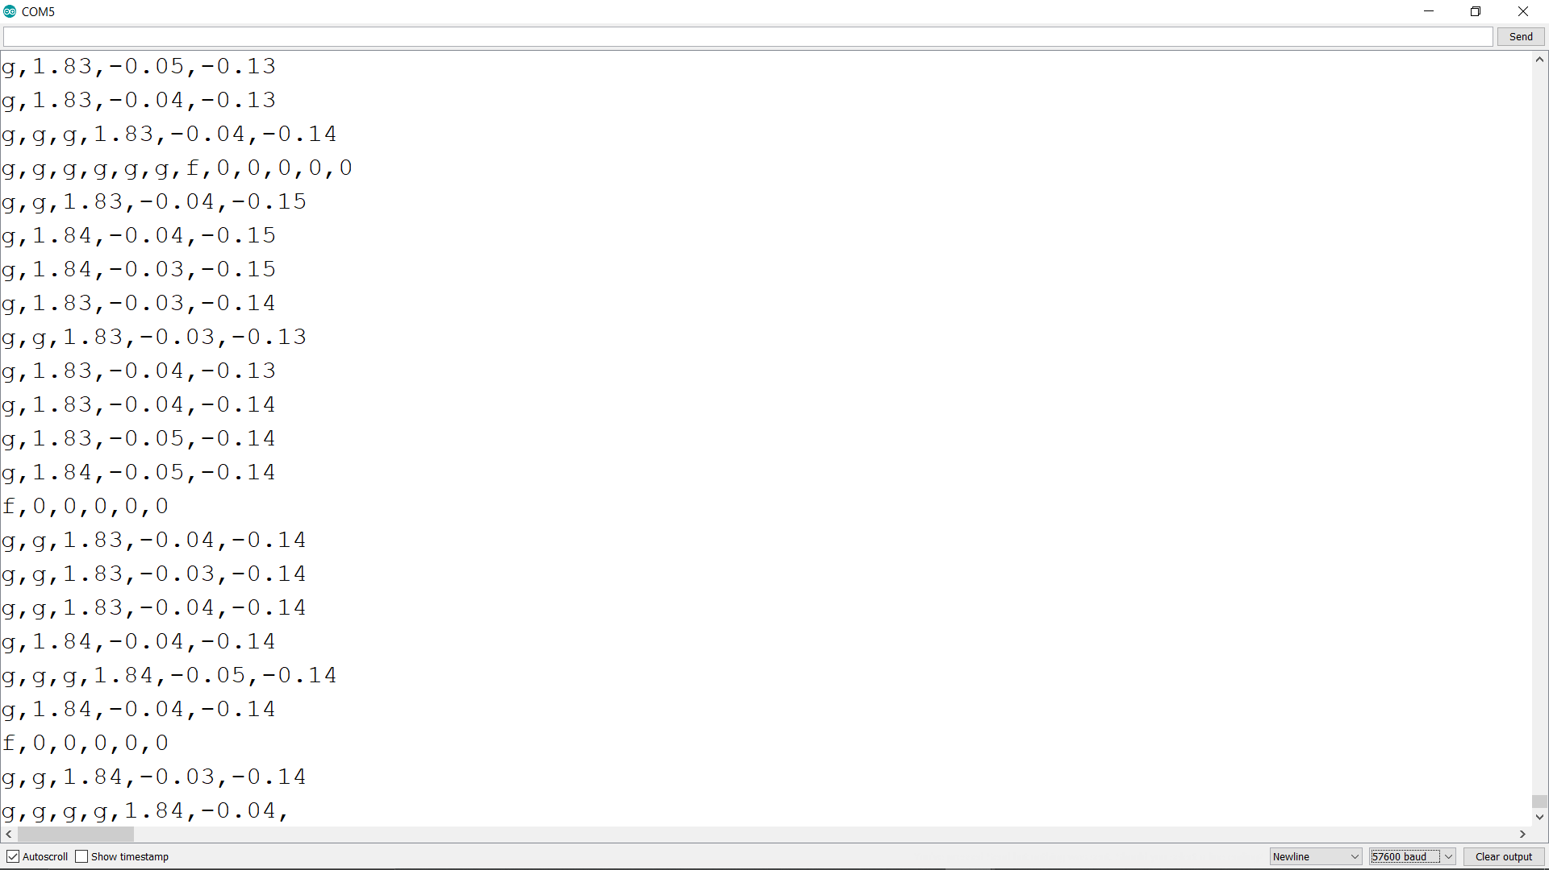
Arduino
Serial communication
Gyroscope data (‘g’)
Relative angle drift from starting point
Flex sensors data (‘f’)
1🡪Flex
0🡪 No flex
Gyroscope initialization phase
Offset is computed
Interrupt detection enabled
The device is ready

Slide 9
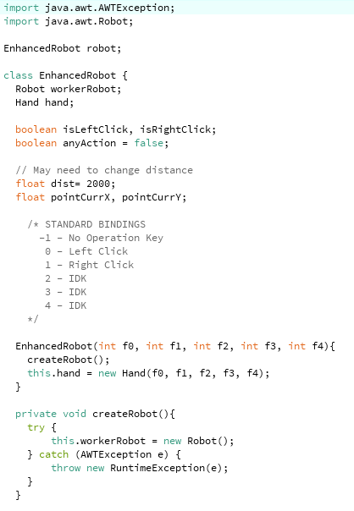
Processing Backend
Wrapper class of the Robot class from java.awt package
Move mouse around and simulate mouse and key presses
Versatile
Able to change the sensors as long as the user tells us which sensor data is which finger

Slide 10
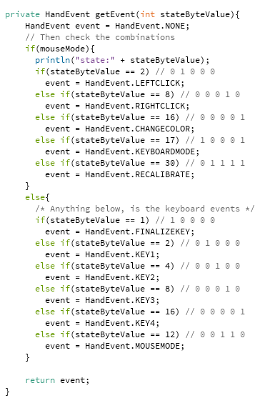
Processing Backend
Main backbone of the program
Each finger is assigned a Boolean (0 for unbent, 1 for bent)
For each event, there is comment describing how to activate the event
(thumb, index, middle, ring, pinky)
Two Modes
Mouse mode, able to click
Keyboard mode, able to type

Slide 11

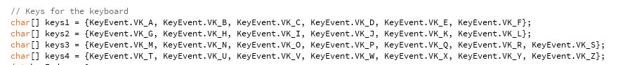
Processing Backend
G
H
I
J
K
L
M
N
O
P
Q
R
S
A
B
C
D
E
F
Keyboard option (similar to phone keypad) by flexing the finger multiple times to switch to character
Thumb: Send character
Index: A – F
Middle: G – L
Ring: M – S
Pinky: T - Z
T
U
V
W
X
Y
Z
SEND

Slide 12

Processing Frontend

Slide 13
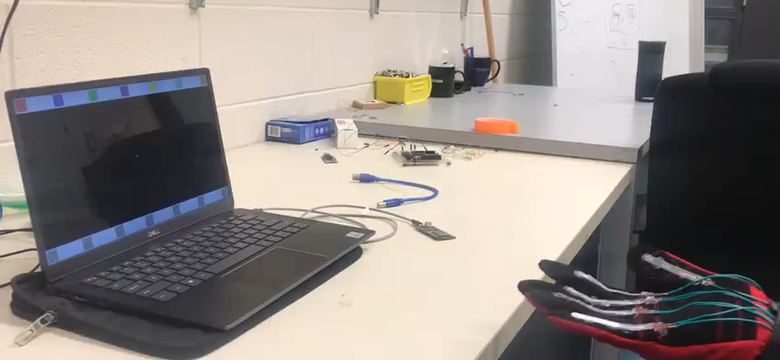
Processing Frontend

